Slide 1
Key Principles of agile in enterprise architecture (2)

Slide 2
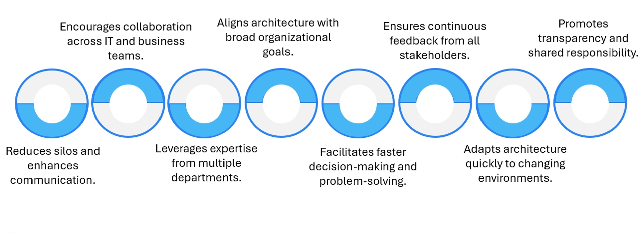
Collaboration And Cross-Functional Teams

Slide 3
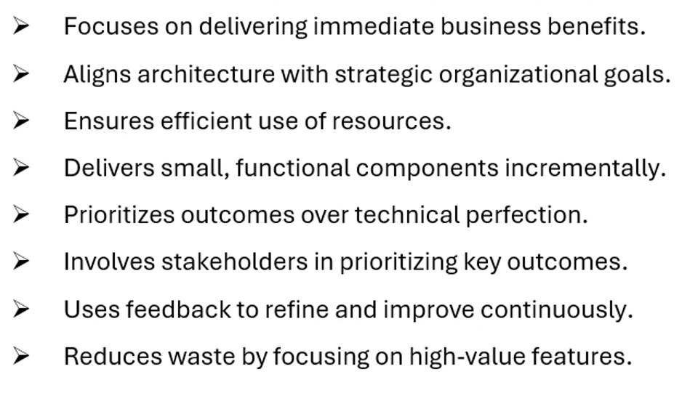

Value – Driven Approach

Slide 4
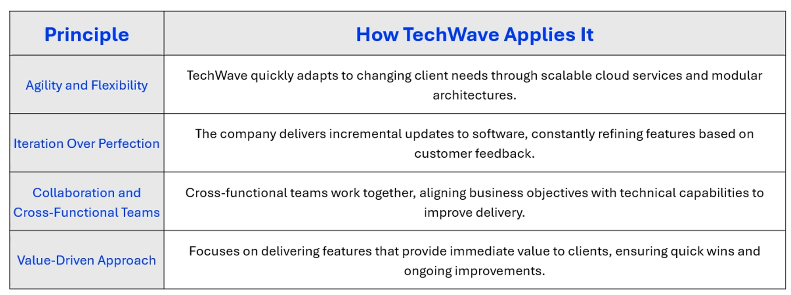
TeahWave Embracing Principles Of Agile In Enterprise Architecture

Slide 5
Thank You

